Slide 1

IMDB Movie Analysis
By Rohit Paul

Slide 2
Overview
This project is based on IMDB movie analysis.
As an analyst we have to go through the data and frame the problems.
By asking “What are the problems?” we can shed some light on the problems and answers those 5 “Why?”s to understand the root cause & provide better, to the point insights.

Slide 3
Approach
The data for this project is already provided by .csv format.
After importing the data into excel number of tasks are performed to understand and clean the datasheet. The tasks are:
Understanding the columns, data. Trying to get an overview of the data.
Dropping rows with missing data points.
Creating pivot tables and charts to analyze the data properly.
After the data in cleaned and pivot tables are created, formulas are applied to get the required answers.
Charts are then prepared with the help of those pivot tables and and the values that were calculated previously.

Slide 4
Techstack used
To analyze the data and to create easily understandable charts Microsoft Excel & Power BI is used.
Later Google Slides in used to create this presentation.

Slide 5
Insights & Results

Slide 6
Cleaning the Data
Cleaning the data is one of the important and preliminary steps in any analysis process.
In this process, the imported data is transformed into a table format. Then with the help of different technique and tools, rows with null values are dropped and duplicate values are deleted.
Initially the table had 28 columns & 5044 rows. After the data is cleaned, the table reduced to 28 columns & 3769 rows.

Slide 7
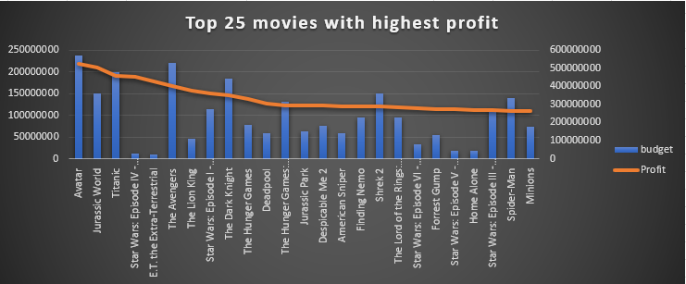
Movies with highest profit
To calculate the profit for each movie titles, a new “Profit” column is introduced to the datasheet.
Profit is calculated by calculating the difference between Gross and Budget column.
The formula used is: =[@gross] - [@budget]
Here’s a chart of top 25 movies with highest profit.
The top 3 movies with highest profit are:
Avatar
Jurassic World
Titanic

Slide 8
IMDB Top 250
To find out top 250 movies of imdb a new column is introduced named “IMDB_Top_250”
With the help of IF formula the movies are found with more than 25,000 num_voted_users. Then the column is sorted from largest to smallest value based on the number of reviews and top 250 movies are selected and gathered.
The formula used: =IF(IMDB_Movies4[@[num_voted_users]]>25000, IMDB_Movies4[@[num_voted_users]], 0)
After the formula is applied movies with value “0” are filtered out.
Again IF formula is used to check if the movie is in foreign language.
The formula used: =IF([@language]<>"English", [@[movie_title]], "-")
After the formula is applied rows containing value “-” is filtered out to find out top foreign language imdb film.

Slide 9
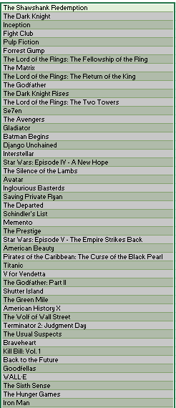
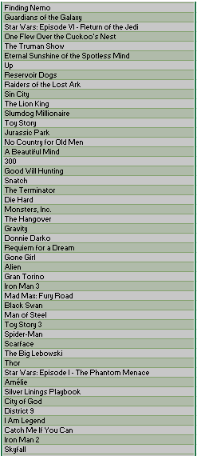
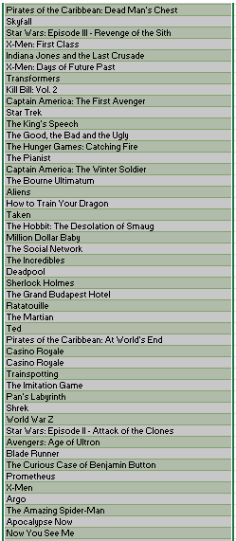
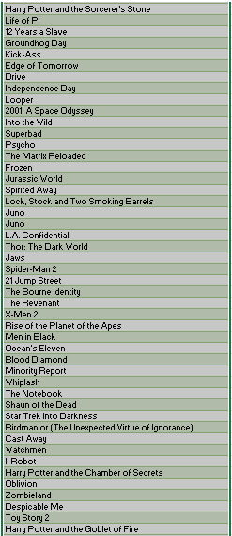
IMDB Top 250 list

Slide 10
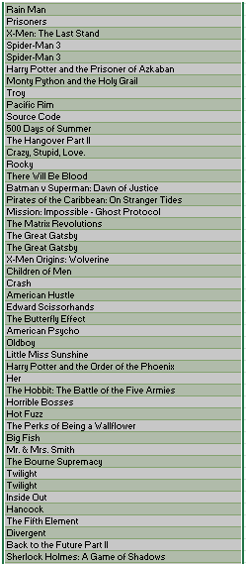
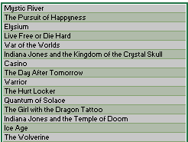
IMDB Top 250 list

Slide 11
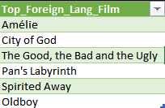
IMDB Top Foreign language film
These are the top foreign language film within top 250 IMDB movies.

Slide 12
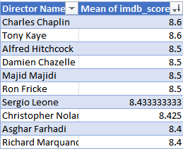
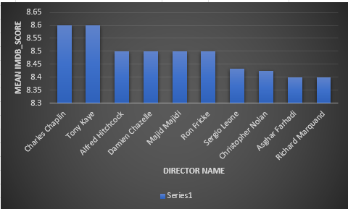
Best Directors
To find the best director Pivot table is created where mean of every director is calculated based on imdb_score.
Then the name of top 10 Directors are collected with highest mean of imdb_score.

Slide 13
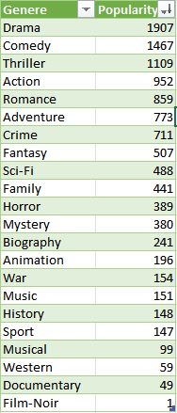
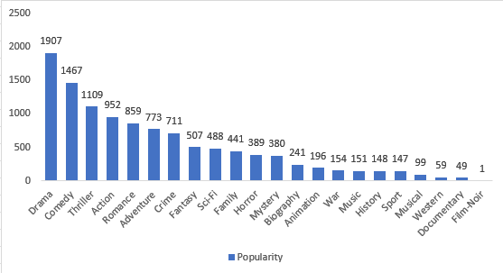
Popular genres
The popular genres could be found by selecting the genre column & using “|” as delimiter genres are separated & by using UNIQUE formula unique genres are collected.
Then using COUNTIF formula we can easily get number of times a genre keyword has occurred in the movies in the datasheet.
We can see that the most popular genres are:
Drama
Comedy
Thriller
Action
Romance

Slide 14

Charts for Movies & Actors
To calculate the mean of the num_critic_for_reviews & num_users_for_review for three lead actors namely ‘Meryl Streep’, 'Leonardo DiCaprio' & 'Brad Pitt' three new data frames namely, Meryl_Streep, Leo_Caprio, and Brad_Pitt are created.
Then, the rows of all these data frames are appended and stored them in a new data frame named combined.
Then, 'Combined' data frame is grouped by using the actor_1_name column & mean of the num_critic_for_reviews and num_users_for_review are calculated.
From this table we can see that Leonardo DiCaprio has the highest mean of the num_critic_for_reviews and num_users_for_reviews.

Slide 15
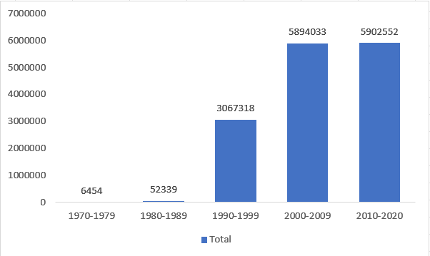
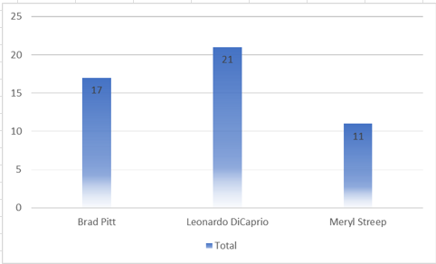
Charts for Movies & Actors
From this above chart we can see the number of users voted for these 3 lead actors over the decades.
From this bottom chart we can see the number of movies the lead actors have done in these time.

Slide 16
Conclusion
From above analysis we can draw a conclusion that, this project has much more diverse dataset thus, focusing on data cleaning and analysis is must. Working on this project enriched my knowledge and created a clear concept about data analysis.
By calculating the profit of every film we can get an insight on how movies are selling and which type of stories and genres that people are liking.
By analysing the top 250 movies we can get an insight about the top grossing and highly rated movies of of all time.
By analysing the top rated directors we can have an insight of which director is making the most popular movies which people are eagerly waiting to watch.
By finding the popular genres we can have an insight of which type of movies are mostly filmed.
From the charts about the actors we can have insights about which actors are doing most number of movies and their popularity over decades.
All these insights will help us to answer the “Why?”s and get the root cause.

Slide 17
Thank You

